Slide 1
Practical MVA - Car Price Estimation
Goktug Cengiz
Henry Qiu

Slide 2
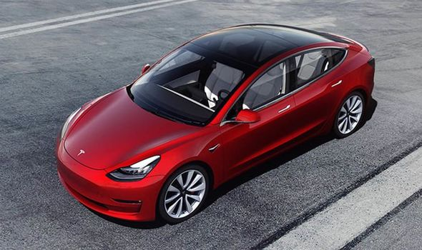
Introduction
The source in this project is the Automobile dataset, provided by the UCI Machine Learning Repository. One of the most significant question we wanted to answer with this project was to find how much of an impact does some features play a role in determining the price of that car with using multivariate analysis techniques.

Slide 3
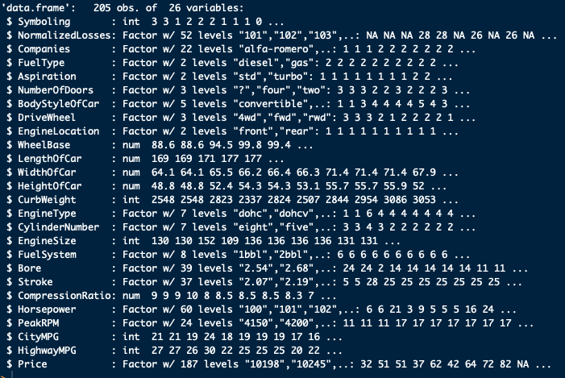
Data Understanding
205 Observations
26 Variables

Slide 4
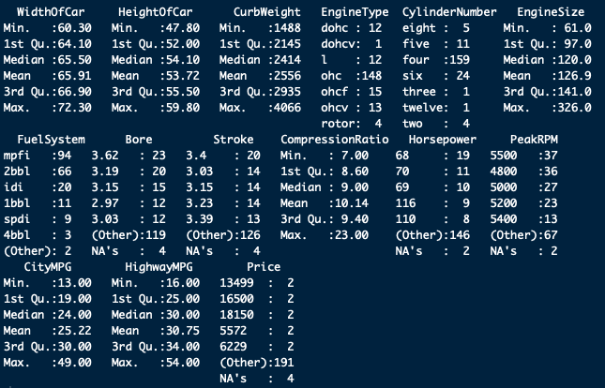
Data Understanding
Summary of Data set

Slide 5
Data Pre-processing
Feature Selection
Recoding Variable
Data Cleaning

Slide 6
Feature Selection
The 'Symboling' and 'Normalized Losses' columns were removed as these were introduced for insurance risk assessment purposes and are not meaningful to this study.
"EngineLocation" variable was excluded and will be explained why in visualization section.
"Stroke" variable was excluded and will be explained why in visualization section.

Slide 7
Recoding Variables
Some of variables which are called as "Bore", "Stroke", "HorsePower", "PeakRPM" and "Price" were converted to character, then numeric or integer type.

Slide 8
Data Cleaning
Missing Value Detection
Missing Value Imputation
Outlier Detection (Univariate and Multivariate)
Outlier Treatment

Slide 9
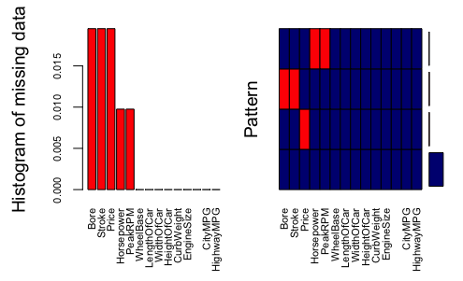
Missing Value Detection
Missing Values are visualized by Histogram
Variables sorted by number of missings

Slide 10
Missing Value Imputation
Missing values were imputed thanks to missForest package in R. ’missForest’ is used to impute missing values particularly in the case of mixed-type data. It can be used to impute continuous and/or categorical data including complex interactions and non-linear relations. It yields an out-of-bag (OOB) imputation error estimate. Moreover, it can be run parallel to save computation time. Consequently, we have both of continuous and categorical variables to be imputed that’s why we use it.

Slide 11
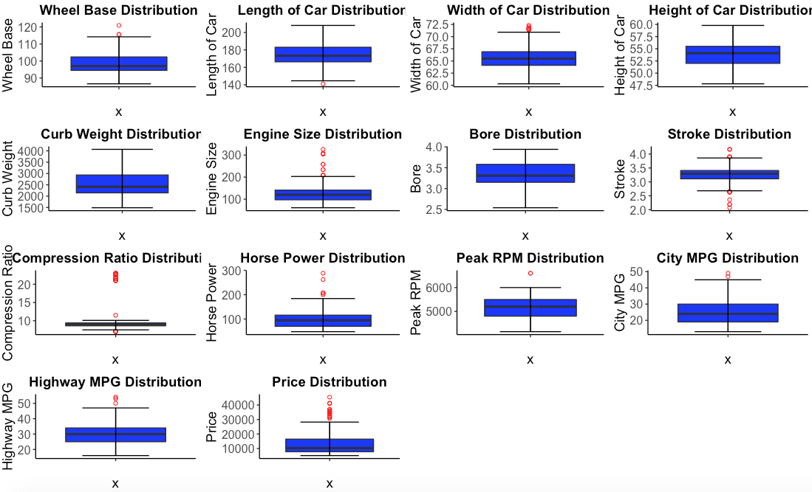
Univariate Outlier Detection
"WheelBase", "LengthOfCar"," WidthOf-Car", "EngineSize", "Stroke", "CompressionRatio", "Horsepower", "PeakRPM", "CityMPG", "HighwayMPG"

Slide 12
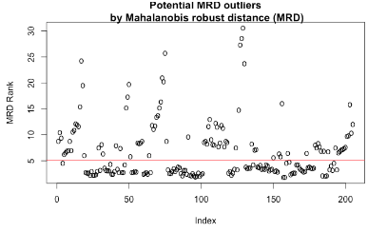
Multivariate Outlier Detection
The Mahalanobis distance was used of each data instance against the distribution of the whole data set to have an outlier score for each point. We can see how many points are considered outliers with each distance given a cutoff point with confidence level % 97.5.

Slide 13
Outlier Treatment
We found indexes of outlier values which were detected.
We brought outlier values from our data set using these indexes.
We assigned NA Values to outlier values.
NA Values were imputed by Random Forest.
As a result, we obtained new values and outliers treated.

Slide 14
Descriptive Analytics
We used some of methods (below) to find associations. (to explore)
Visualization
Principal Component Analysis
Clustering

Slide 15
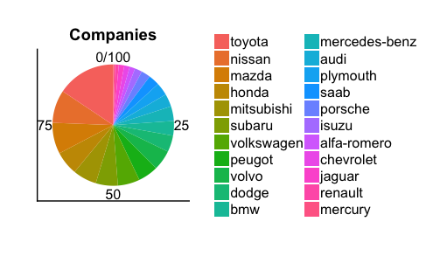
Visualization by Pie Charts for Categorical Values
When we consider all pie charts plots, we can say that companies have broad distribution.

Slide 16
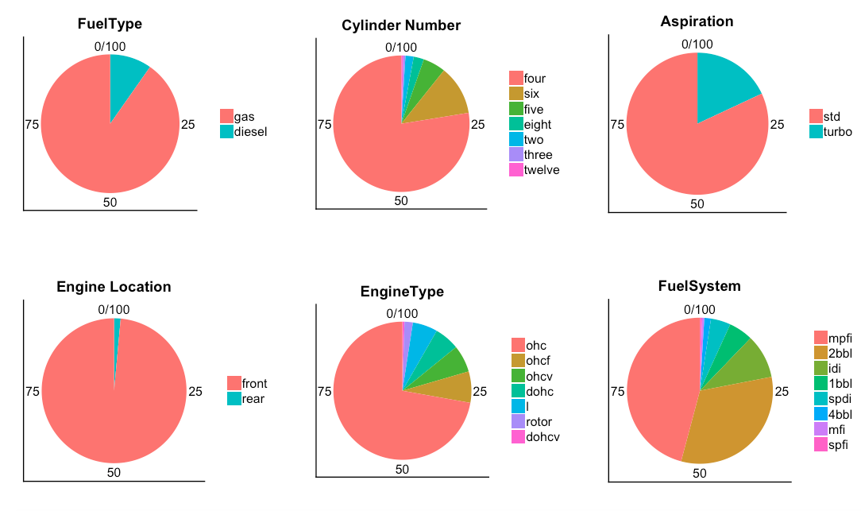
Visualization by Pie Charts for Categorical Values
On the other hand, Engine Location has narrow distribution and it will be excluded from our dataset. We could not observe any problem about other variables.

Slide 17
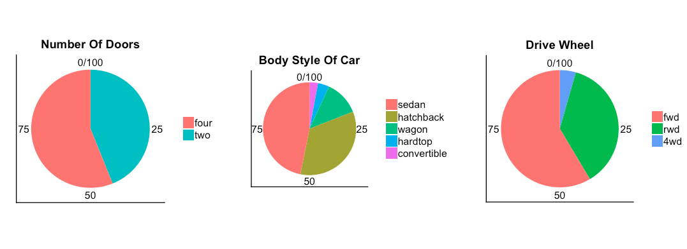
Visualization by Pie Charts for Categorical Values

Slide 18
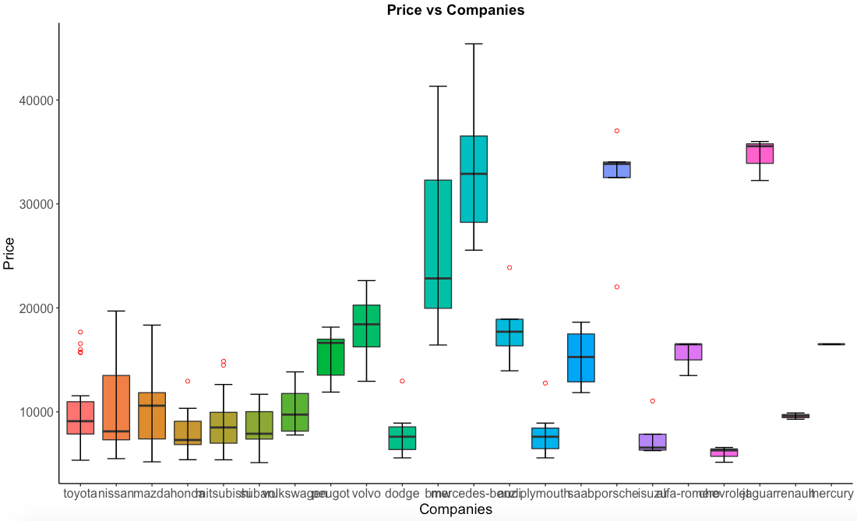
Visualization
High Prices:
Mercedes
BMW
Jaguar

Slide 19
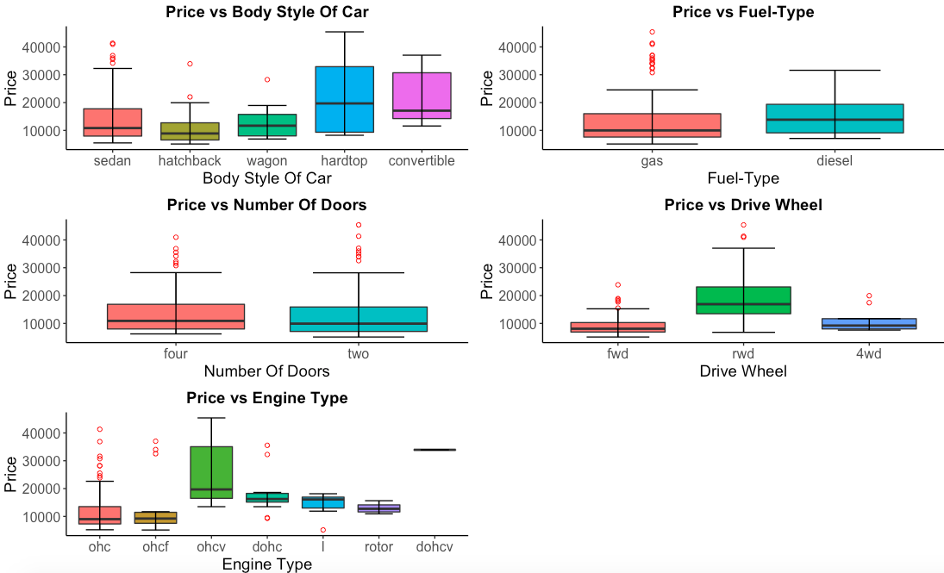
Visualization
Bivariate description for Categorical Variables (Target vs Categorical Variables)

Slide 20
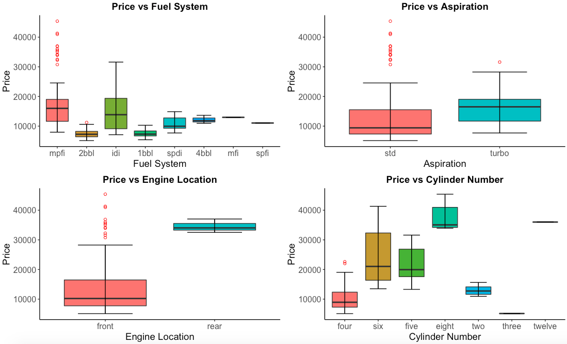
Visualization
Bivariate description for Categorical Variables (Target vs Categorical Variables)

Slide 21
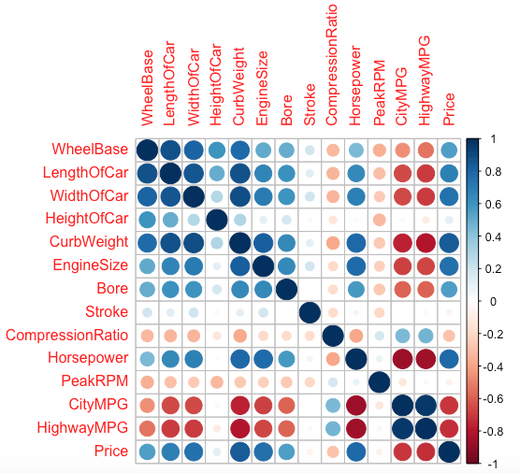
Visualization by Correlation Table
Correlations between continuous variable.

Slide 22
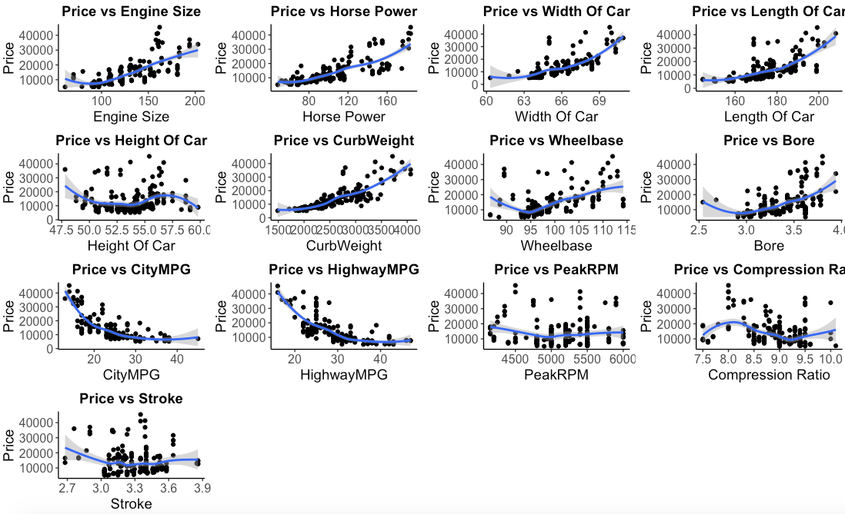
Visualization
Bivariate description for Continuous Variables (Target vs Continuous Variables)

Slide 23
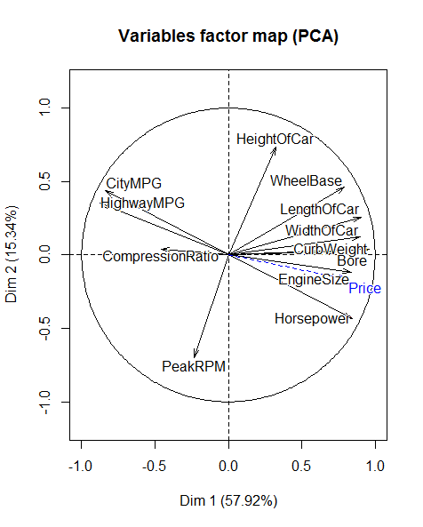
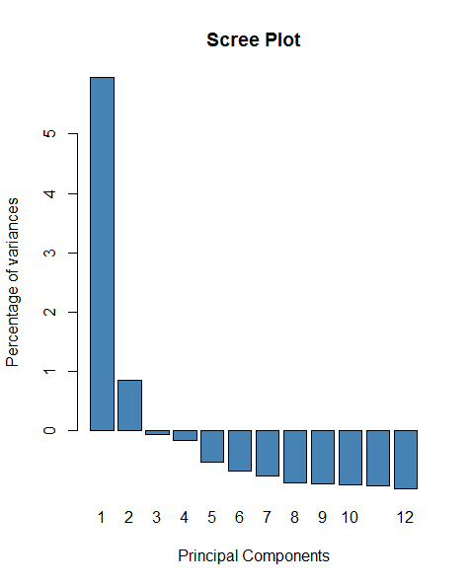
Principal Component Analysis

Slide 24
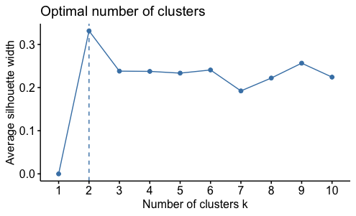
Clustering
To identify optimal number of cluster
Elbow Method
Average Silhouette
Gap Statistic

Slide 25
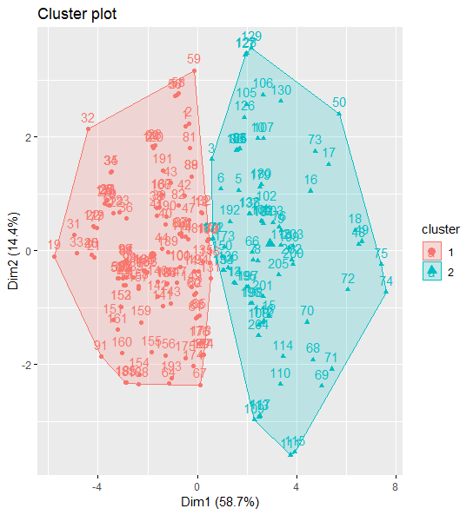
Clustering
Method: K-means

Slide 26
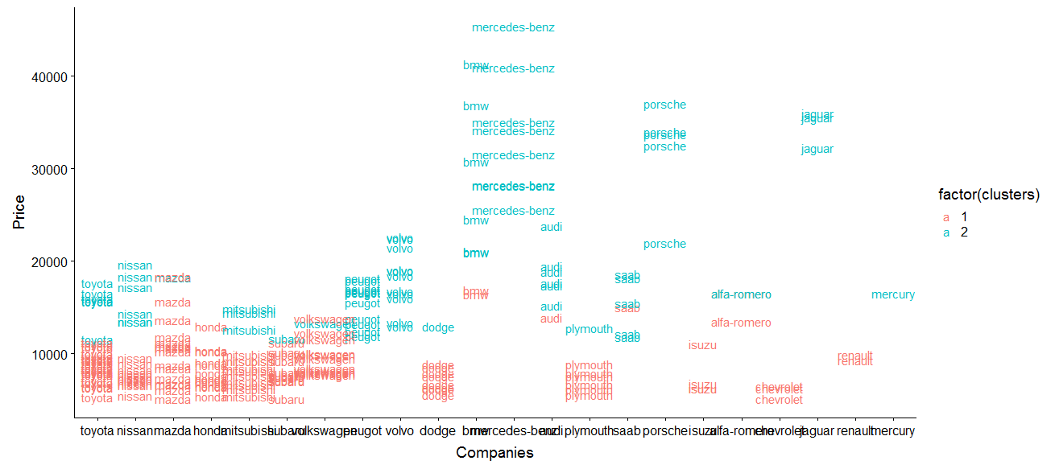
Clustering

Slide 27
Prediction model
Aim
Predict prices of the cars based on the available features
Data Partitioning
80% Training data
20% Testing data

Slide 28
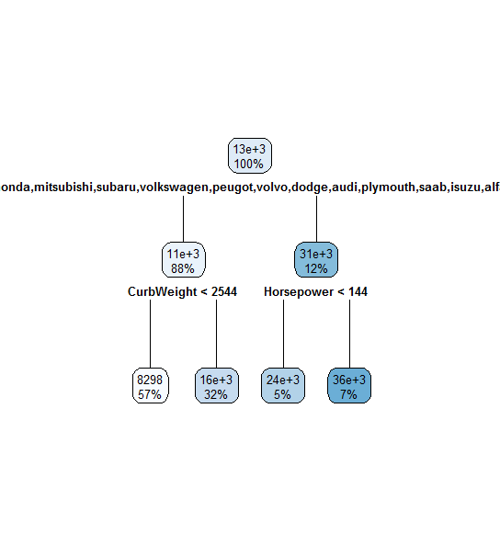
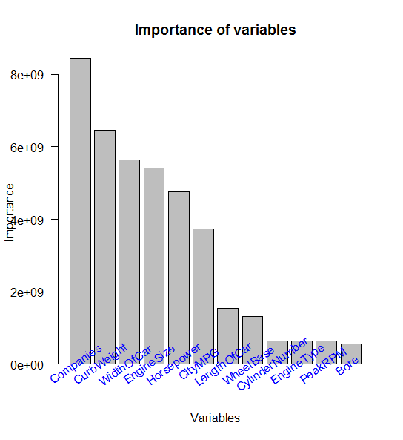
Decision Tree

Slide 29
Conclusion
2 significant dimensions in PCA
2 different clusters
Brand > Power ?

Slide 30

Thank You!

